Slide 1


B.TECH PROJECT 2025
INDIAN INSTITUTE OF INFORMATION TECHNOLOGY VADODARA
On campus Mentor : Dr. Swapnil Lokhande Off- Campus Mentor : Dr. Sanjay Saxena
Presented by : Vasireddy Satvika, 202151175

Slide 2
Predicting Bladder Cancer
Recurrence using Machine Learning

Slide 3
01. Introduction
02. About the Dataset
03. Challenges Faced
04. Steps to Achieve
05. Methodology
06. Feature Extraction
07. Classification
08. Conclusion
Contents
              --------------------------------------------------------------------

Slide 4
Introduction :
Bladder cancer is the one of the most recurring cancers in the world.
Recurrence in cancer refers to the return of cancer after treatment . range from 50% to 70% within 5 years.
Traditional clinical models for bladder cancer prediction have shown limited accuracy,
EORTC risk tables , CUETO scoring model tend to overestimate
Machine learning offers a promising solution to enhance prediction.
Main motive ? model predict bladder cancer recurrence using raw images and clinical data..

Slide 5
About the Dataset :
Source : TCGA-BLCA from the cancer imaging archive
The images of patients are in Dicom format
The total images in the Dataset (CT, CR, MR, PT, DX), is 111,781
There is lot of data missing from the columns
High risk individuals are people with smoking, and have previous history of cancer,
Patients age ranges from 58 years to 86 years
Importantly the tumour size!!

Slide 6
Challenges Faced
1.
Lack of Ground Truth: Since there is no explicit recurrence label, proxy labels from GitHub, based on tumor detection and expert annotations were used.
2.
Limited Dataset Size: The Clinical and Histopathology dataset has lot of missing values and images, which is a limitation for model choosing and training
3.
Radiomics Complexity: Extracting meaningful features from the images required careful preprocessing and feature selection.

Slide 7
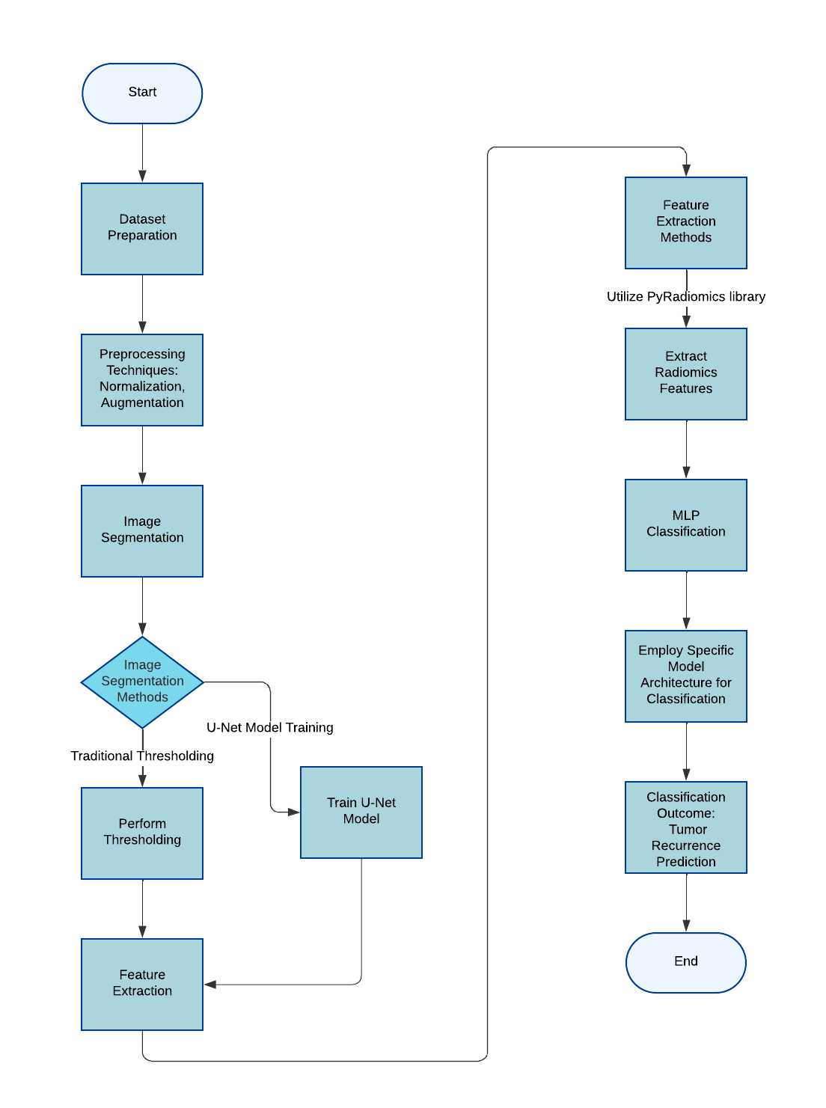
Flowchart
Model Training &
Classification
Segmentation & masked image generation
Model Validation

Slide 8
Feature Extraction
Radiomics features extracted from segmented tumor areas.
Categories: 1.) shape-based
2.) texture-based
3.) intensity, etc.
Per patient features saved in a CSV file with first order statistics, Texture based features
Around ~300 features extracted per patient.

Slide 9
Radiomics and Clinical dataset merging
Merged the Radiomics file and Clinical Dataset file based in Patient_Id
age_at_diagnosis — Patient’s age when diagnosed with bladder cancer
Gender, tumor_stage — broad categorization of tumor severity (0to4)
primary_diagnosis — Describes cancer subtype or diagnosis details Methodology
smoking_status — Indicates if the patient has a history of smoking
days_to_recurrence — Duration between diagnosis and recurrence event (used for context, not prediction)
recurrence_status — Binary target variable (1 = recurrence, 0 = no recurrence)
Notes:
age_at_index, gender, days_to_recurrence, recurrence_status, prior_treatment

Slide 10
Classification Approach
Classification is binary, distinguishing between recurrence or not
Dataset size limited deep learning applications
Employed K-fold cross-validation
3-layer MLP classifier with specified parameters
BCE as the binary cross-entropy loss function( diff. btw model predictions and actual value)
Adam optimizer is used (adjust the learning rates)
Sigmoid activation function is used in the output layer for binary prediction. 0 or 1

Slide 11
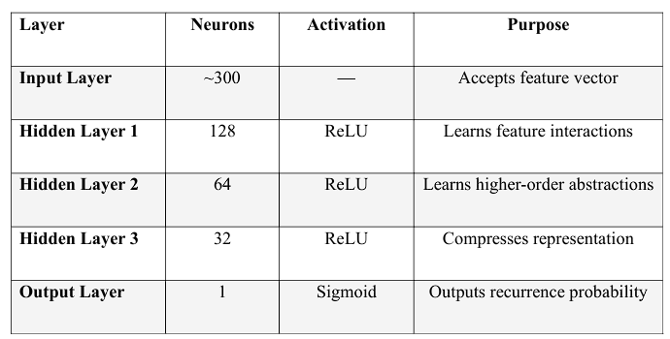
MLP classifier
3-layer MLP classifier with input, 2 hidden layers, Output layer
BCE as the binary cross-entropy loss function
Also implemented mechanism for overfitting of data

Slide 12
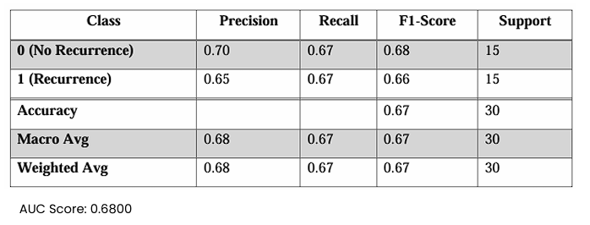
Model Evaluation
Model is evaluated for 5 iterations , Saving best values after each fold
K-Fold results averaged for reliable evaluation
Notes:
The final classification results a balanced model performance across both classes. For class 0 (No Recurrence), the precision was 0.70, recall was 0.67, and F1-score was 0.68. For class 1 (Recurrence), the precision was 0.65, recall was 0.67, and F1-score was 0.66. The overall classification accuracy was 67%, indicating moderate predictive ability. Both macro and weighted averages for precision, recall, and F1-score were consistently around 0.68, reflecting uniform performance across classes without significant bias. Additionally, the model achieved an AUC score of 0.6800, suggesting a fair ability to distinguish between recurrence and non-recurrence cases, and showing a clear improvement over a random classifier.

Slide 13
Conclusion and Future Work
Successful UNet Model Training
Effective Transfer Learning
Next Step: Having more accurate data and increasing the output of the model.
Goal: Develop an accurate model for bladder cancer recurrence prediction to aid clinical decision-making.

Slide 14
References
M. Lucas, I. Jansen, T. G. van Leeuwen, J. R. Oddens, D. M. de Bruin, and H. A. Marquering, "Deep Learning–based Recurrence Prediction in Patients with Non–muscle-invasive Bladder Cancer," Eur. Urol. Focus, vol. 8, no. 1, pp. 165-172, Jan. 2022. Available: https://doi.org/10.1016/j.euf.2020.12.008
The Cancer Imaging Archive, “TCGA-BLCA: The Cancer Genome Atlas Bladder Cancer Collection.” [Online]. Available: https://www.cancerimagingarchive.net/collection/tcga-blca/. Accessed: Feb.16th 2025.
National Cancer Institute, “TCGA-BLCA: The Cancer Genome Atlas Bladder Cancer Project,” Genomic Data Commons, [Online]. Available: https://portal.gdc.cancer.gov/projects/TCGA-BLCA. Accessed: Feb.16th 2025.
D. Malik, mritopng: A DICOM to PNG Conversion Tool, GitHub repository, 2018. Available: https://github.com/danishm/mritopng Accessed: 23rd Feb 2025
"bladder_cancer_dataset," GitHub, 2018. [Online]. Available: https://github.com/17764592882/bladder_cancer_dataset. [Accessed: March 23rd ,2025].

Slide 15
THANK YOU!

